Slide 1
abot
Customer Value, Internal Improvement and Innovation
Mallikarjunarao Kosuri

Slide 2


We all are humans

Slide 3

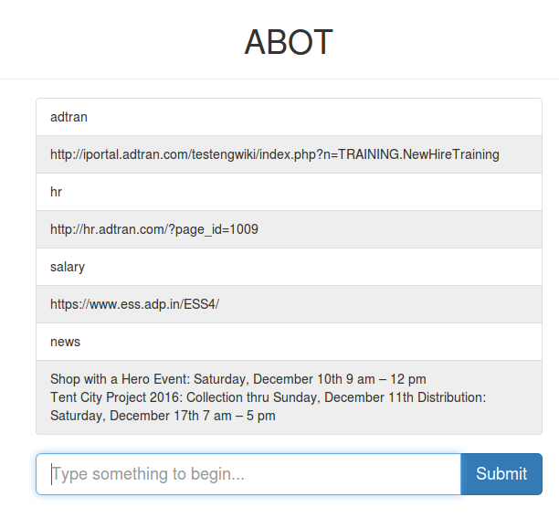
abot
ADTRAN CHAT BOT - To simulate independent language conversation and entertain the user.

Slide 4
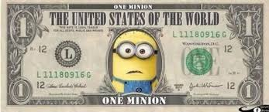
Technical advantages
Support Agents | Chatbots
Customer experience depends on individuals | Uniform customer experience across text based channels
Continues learning and training needed | AI and machine learning ensures self evolvement
Any changes in business process calls for re-training the staff | Changes in business process can be quickly enforced by updating backed software routine.
OPEX($$) increase exponentially to deploy more CSRs for efficient handling of customers in parallel. | Handling multiple customers is only limited by IT hardware.
Response time is dependent on human ability | Can process requests at a much higher efficiency
Higher cost of using voice channels (toll free numbers) for customer support | Lower cost using web chat or different integrations
Regular technical data updation required by humans | Gathers technical information and provides a statics based on demand

Slide 5
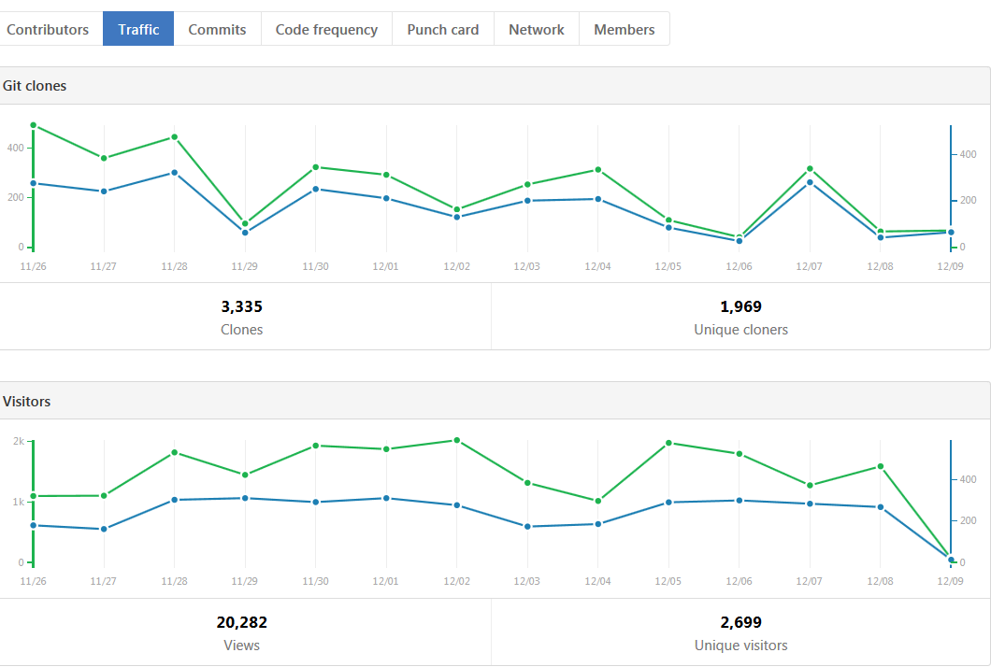
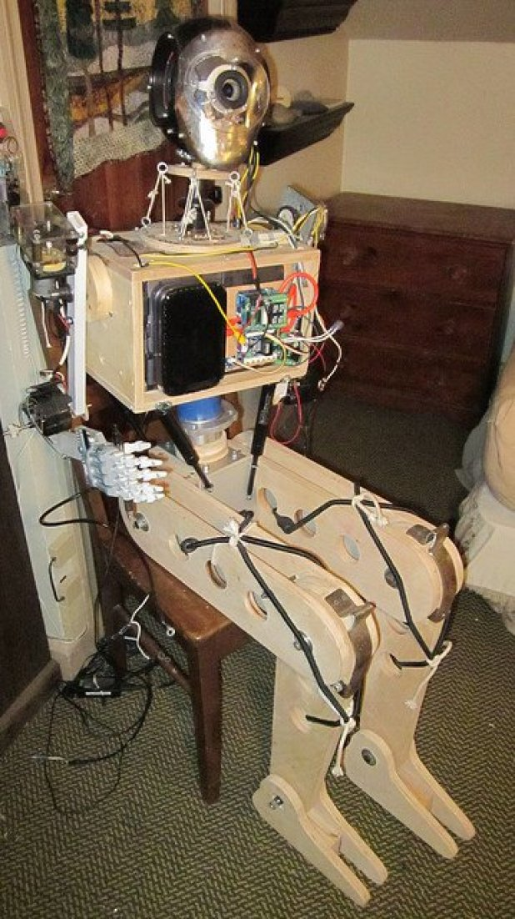
Few Other stats

Slide 6
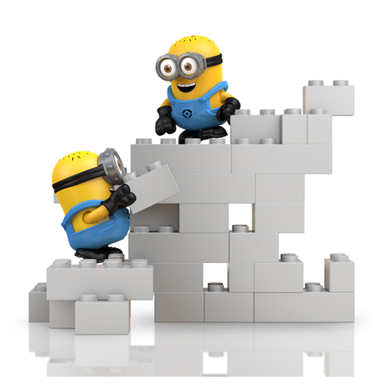

Key success is corpus
Data
Internal
External
Carrier
Enterprise
Support
Mosaic
PMA DPU
TA5K OSP
NV8xx
Tools/ Equipment
Blue socket
NV Enterprise
language

Slide 7

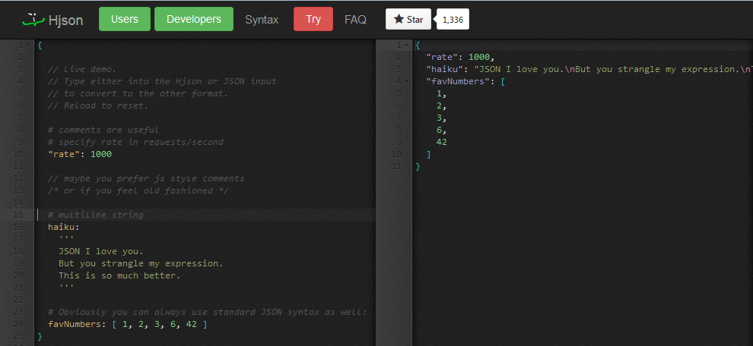

Creating corpus data
Create/Update corpus data
If you found an issue or useful information please make a PR to this repository
https://github.adtran.com/vkosuri/abot/tree/master/src/abot/data
Convert multiline string into a single line
https://hjson.org/try.html

Slide 8
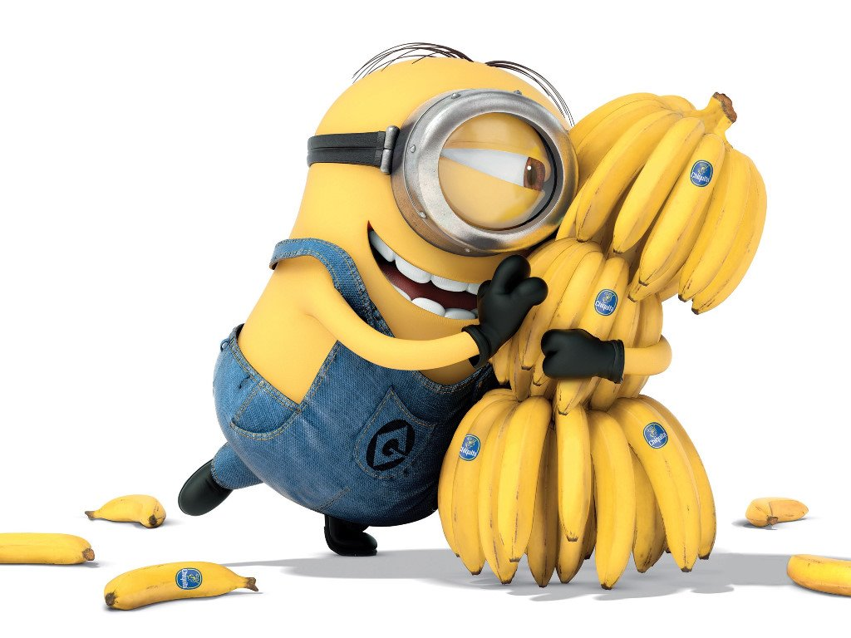
Customer Interactions
Gitter
Twitter
HipChat
Microsoft
MailGun
Speech
Web

Slide 9

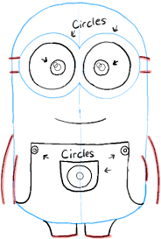

What’s left? What’s the next step?
UI Improvements
Upload and download attachments
Integration images and response
Identifying false responses,
User has ability report false responses.
Monitoring input and output responses.
Corpus Improvements
Programmable statements
Corpus conversion from one LANG to another LANG.
Template mechanism
Import into other formats such PDF, doc, csv and etc.

Slide 10

ask the minions?

